Slide 1
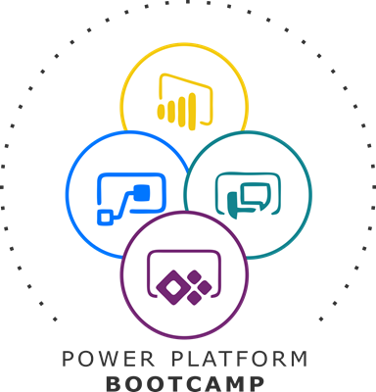

Self Service with Power Apps Portals
Eugene Van Staden
Practice Lead | Business Applications | Intergen

Slide 2
Introduction
Overview
Power Apps Portal Tools
Showcase

Slide 3





Portals momentum
>11M
Monthly Active Users using Portals
500%
Growth in Monthly Active users YoY
>14000
Active Portals, up 50% YoY.
>300M
Monthly Page Views
>200%
Growth in Monthly Page Views YoY
>100M ​
Portal transactions, up 300% YoY​
Notes:
All the new features over the last year – and the support of our great community – have helped PowerApps rapidly grow. We are over 200 billion API calls for the Common Data Service a month. We have over 2.1 PB of data in the Common Data Service. There was a 700% growth in production PowerApps, as well as a 300% growth in PowerApps Active Users. This is fueled by the 2.5 million active Power Platform developers out there.
Thank YOU to everyone in the room and watching for making this possible.
Despite all the momentum – we are not slowing down. We are innovating faster than ever. We have released over 400 new features and improvements.

Slide 4
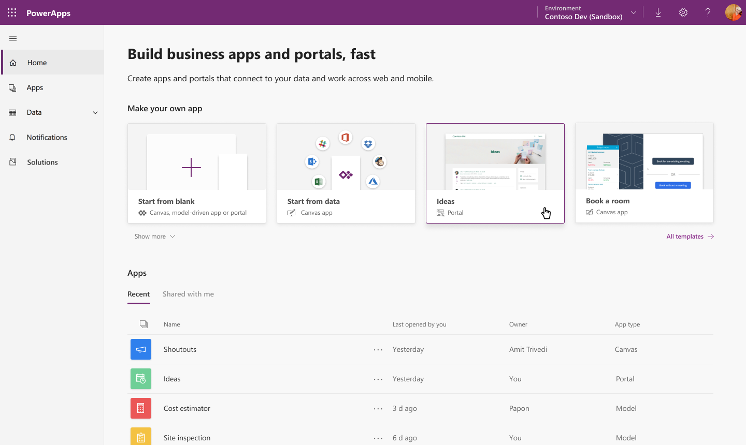
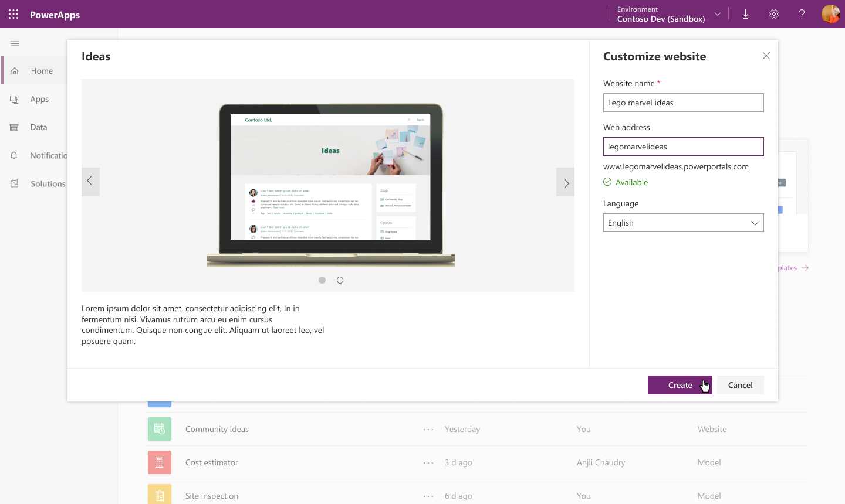
Quick and easy setup experience
Configure a new App type called “portal” from PowerApps home
Create a portal for CDS or Dynamics database
Use a prebuilt Dynamics application template like customer self service, partner management, event management etc or create your own portal.

Slide 5
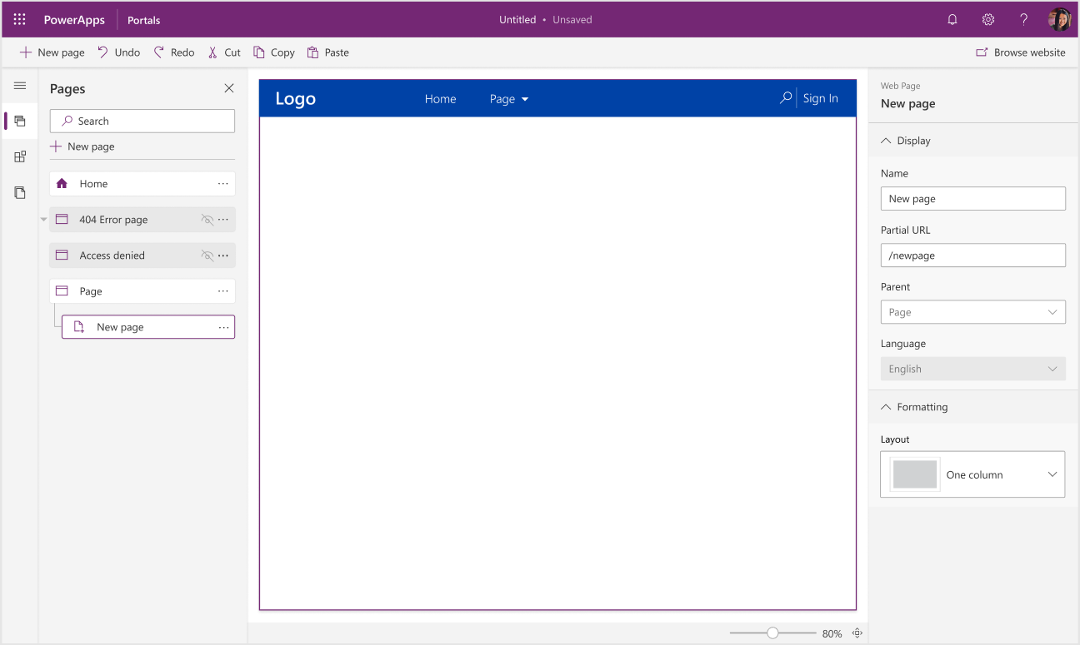
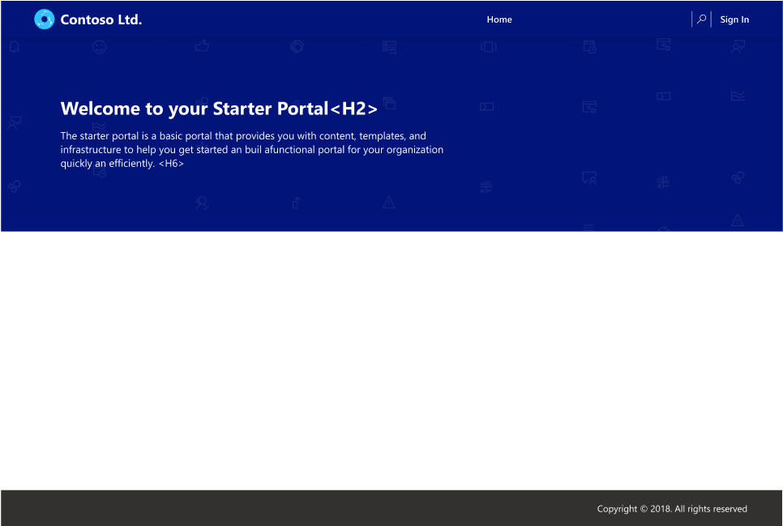
Easy to use Portal Designer Experience
Simplified Portal Designer to customize content of your website.
Create and manage pages in few clicks increasing your productivity multifold
Select predefined layouts or create your own templates (web templates)

Slide 6
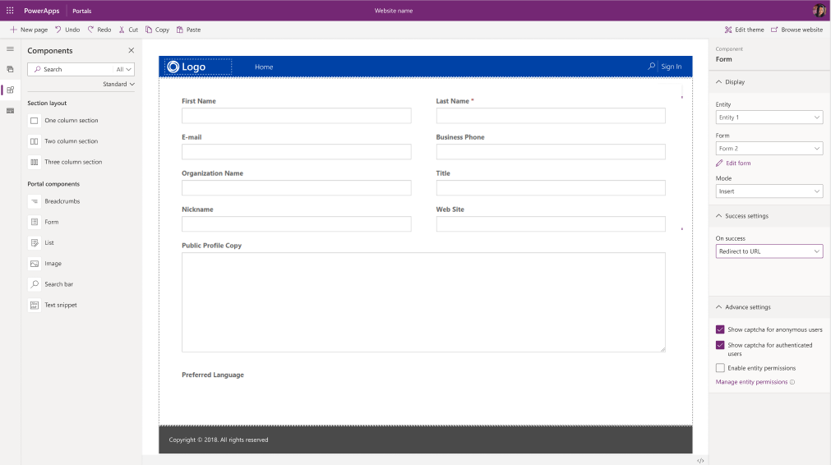
Expose your CDS/Dynamics data in few clicks!
Reuse Model driven app constructs like forms, views, charts, dashboards etc to surface CDS data
One click integration with Form and View designers to help you update/create new forms/views.
Advanced form/view capabilities like CAPTCHA, geolocation, custom actions, workflow actions etc

Slide 7
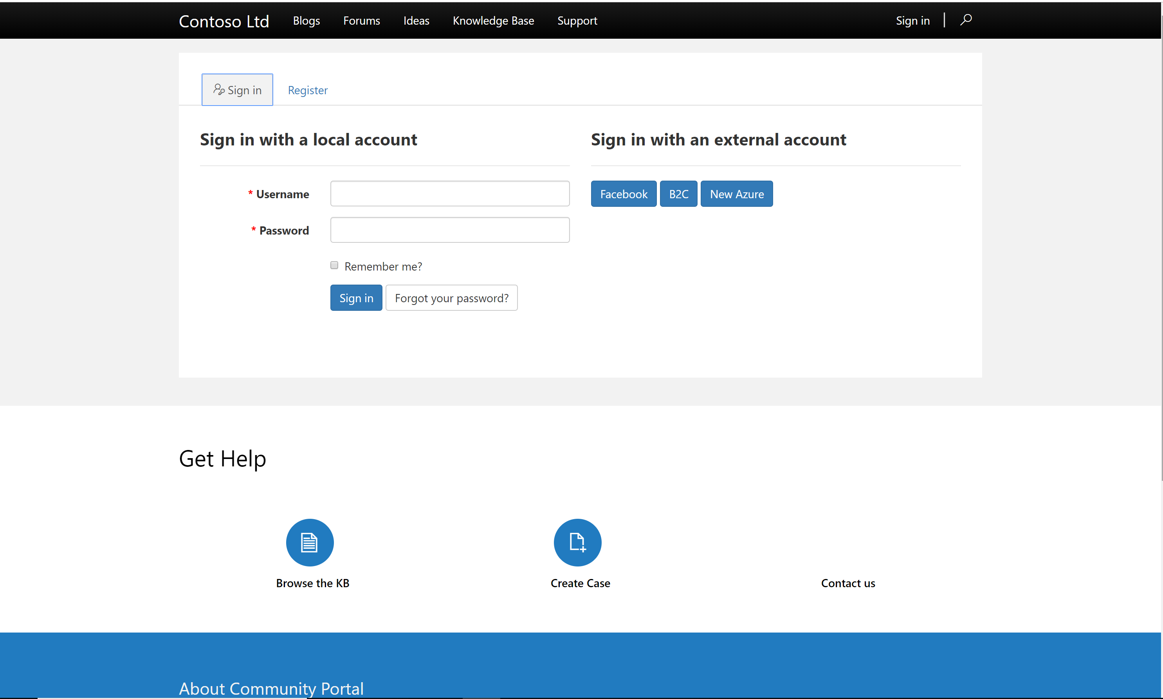
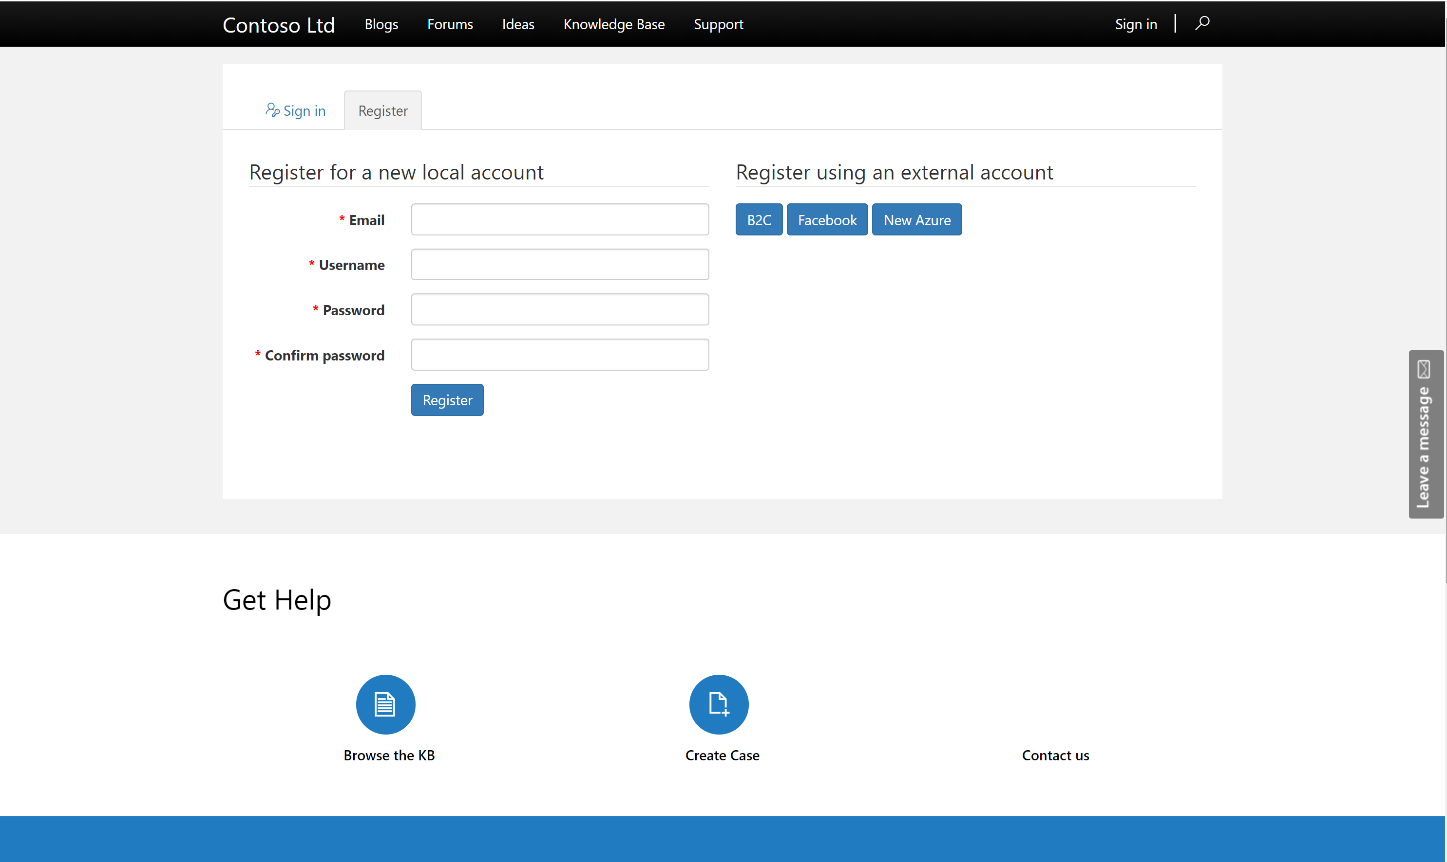
Extend to multiple audiences
Create Portals for users outside your organizations as well as internal employees.
Enable a variety of commercial login providers like Microsoft Account, LinkedIn, Facebook as well as enterprise Identity Providers like Azure AD B2C, Okta, Auth0 etc.
Enable Self Service Registration for end users or extend it to select users.
Enable Anonymous access for select content.

Slide 8
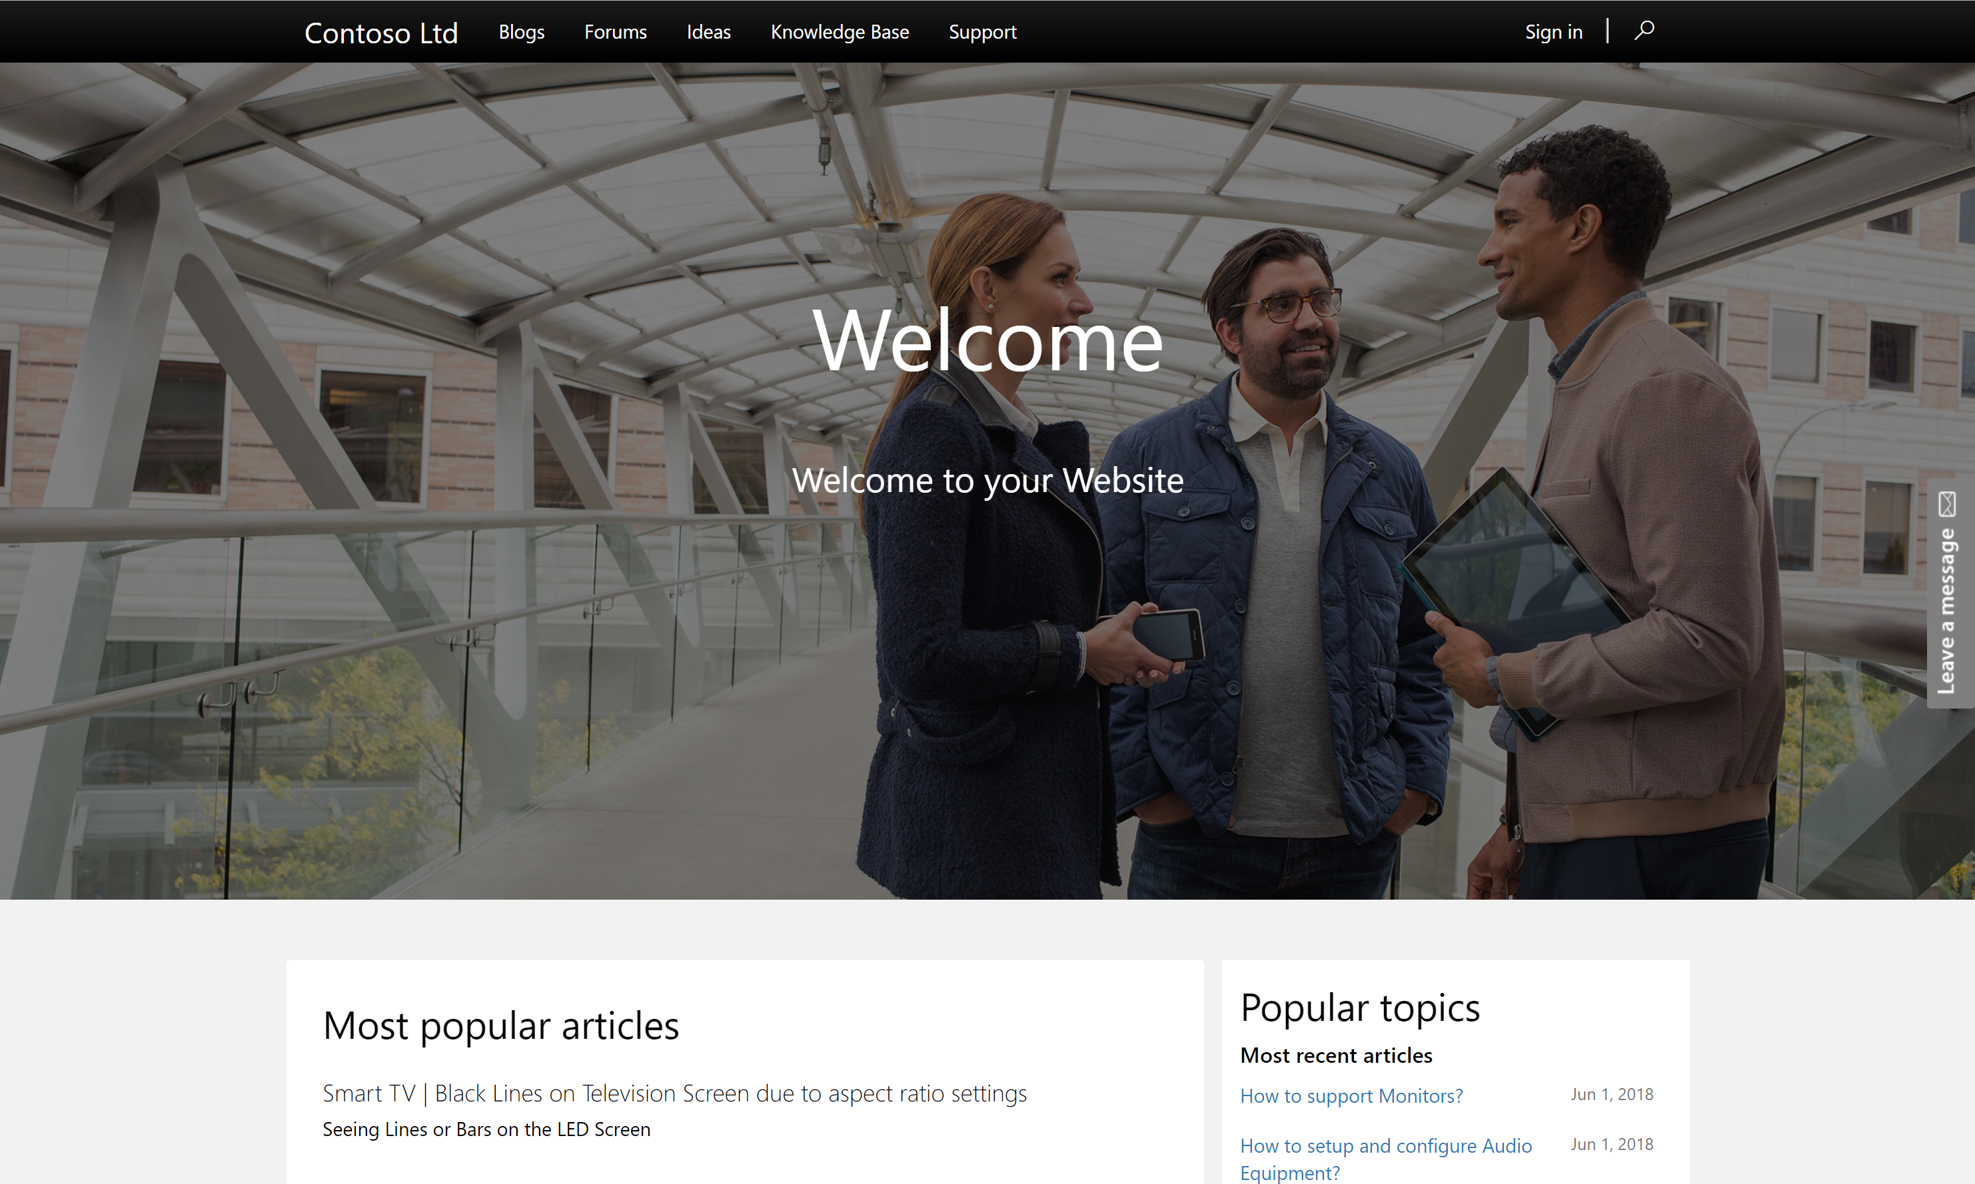
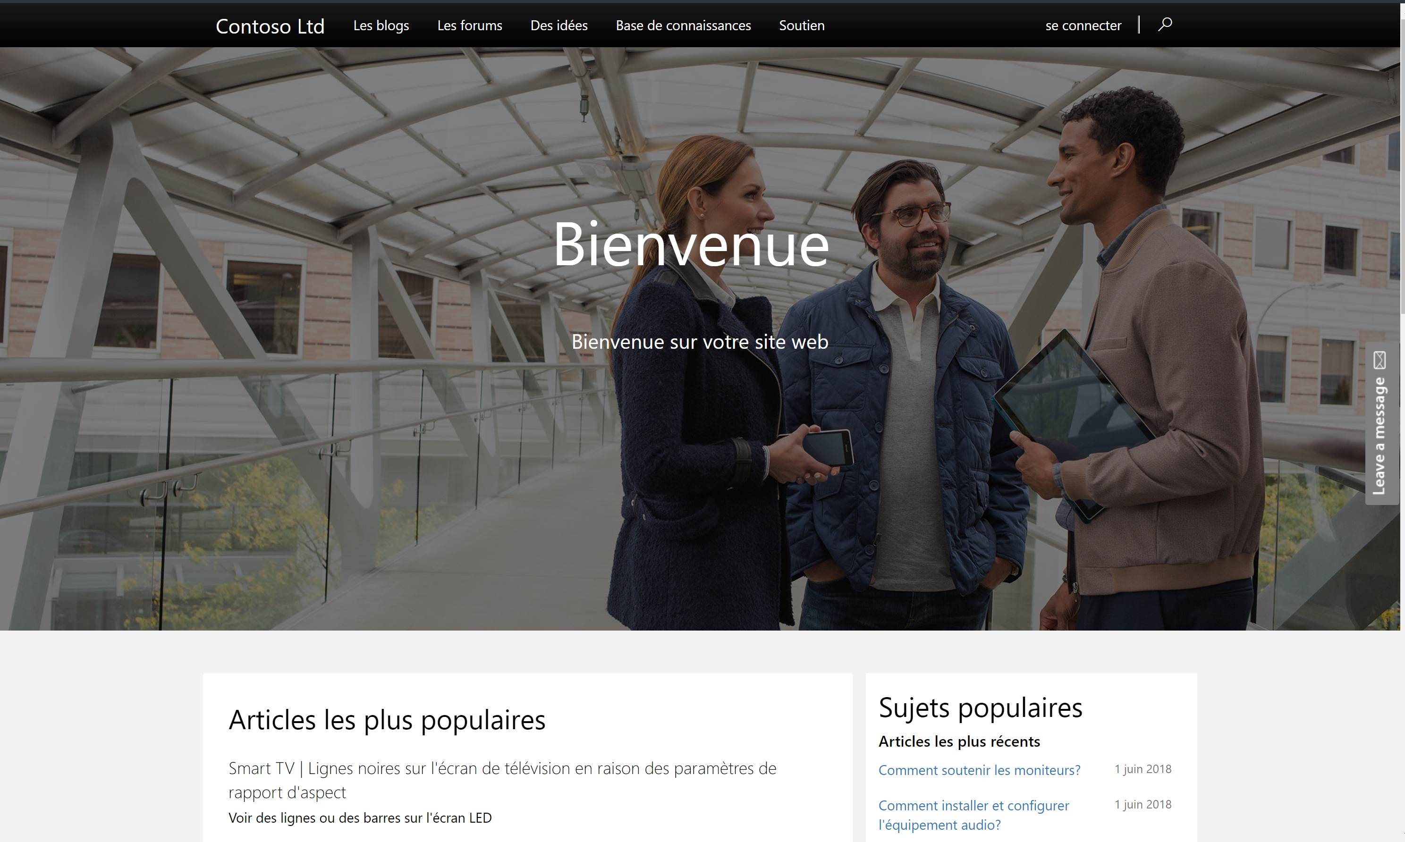
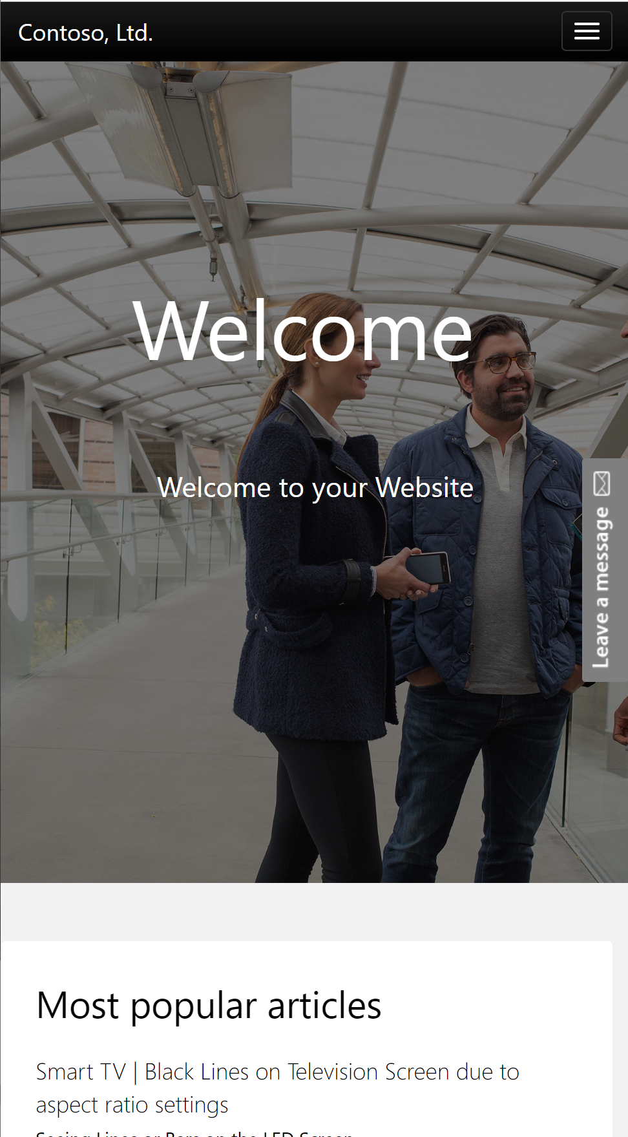
Create Pixel perfect, responsive and multilingual sites
Create pixel perfect websites using your own css or inline styles.
Use bootstrap themes to create responsive sites which work on every surface
Supports 43 base CDS languages (everything except RTL).
Supports language variations (like English(UK), French(Canadian) etc)
Fully accessible controls conforming to various standards.

Slide 9
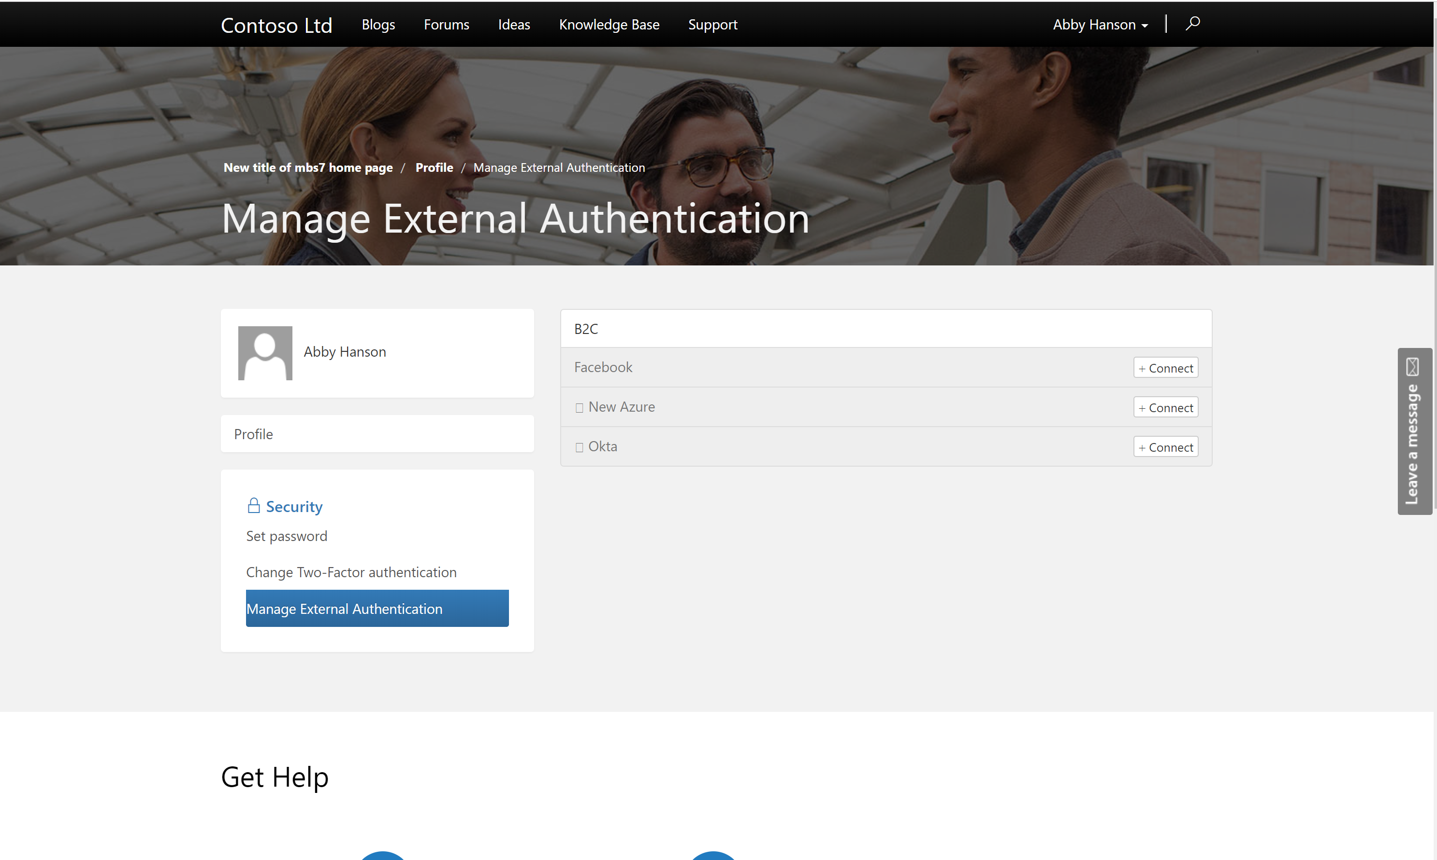
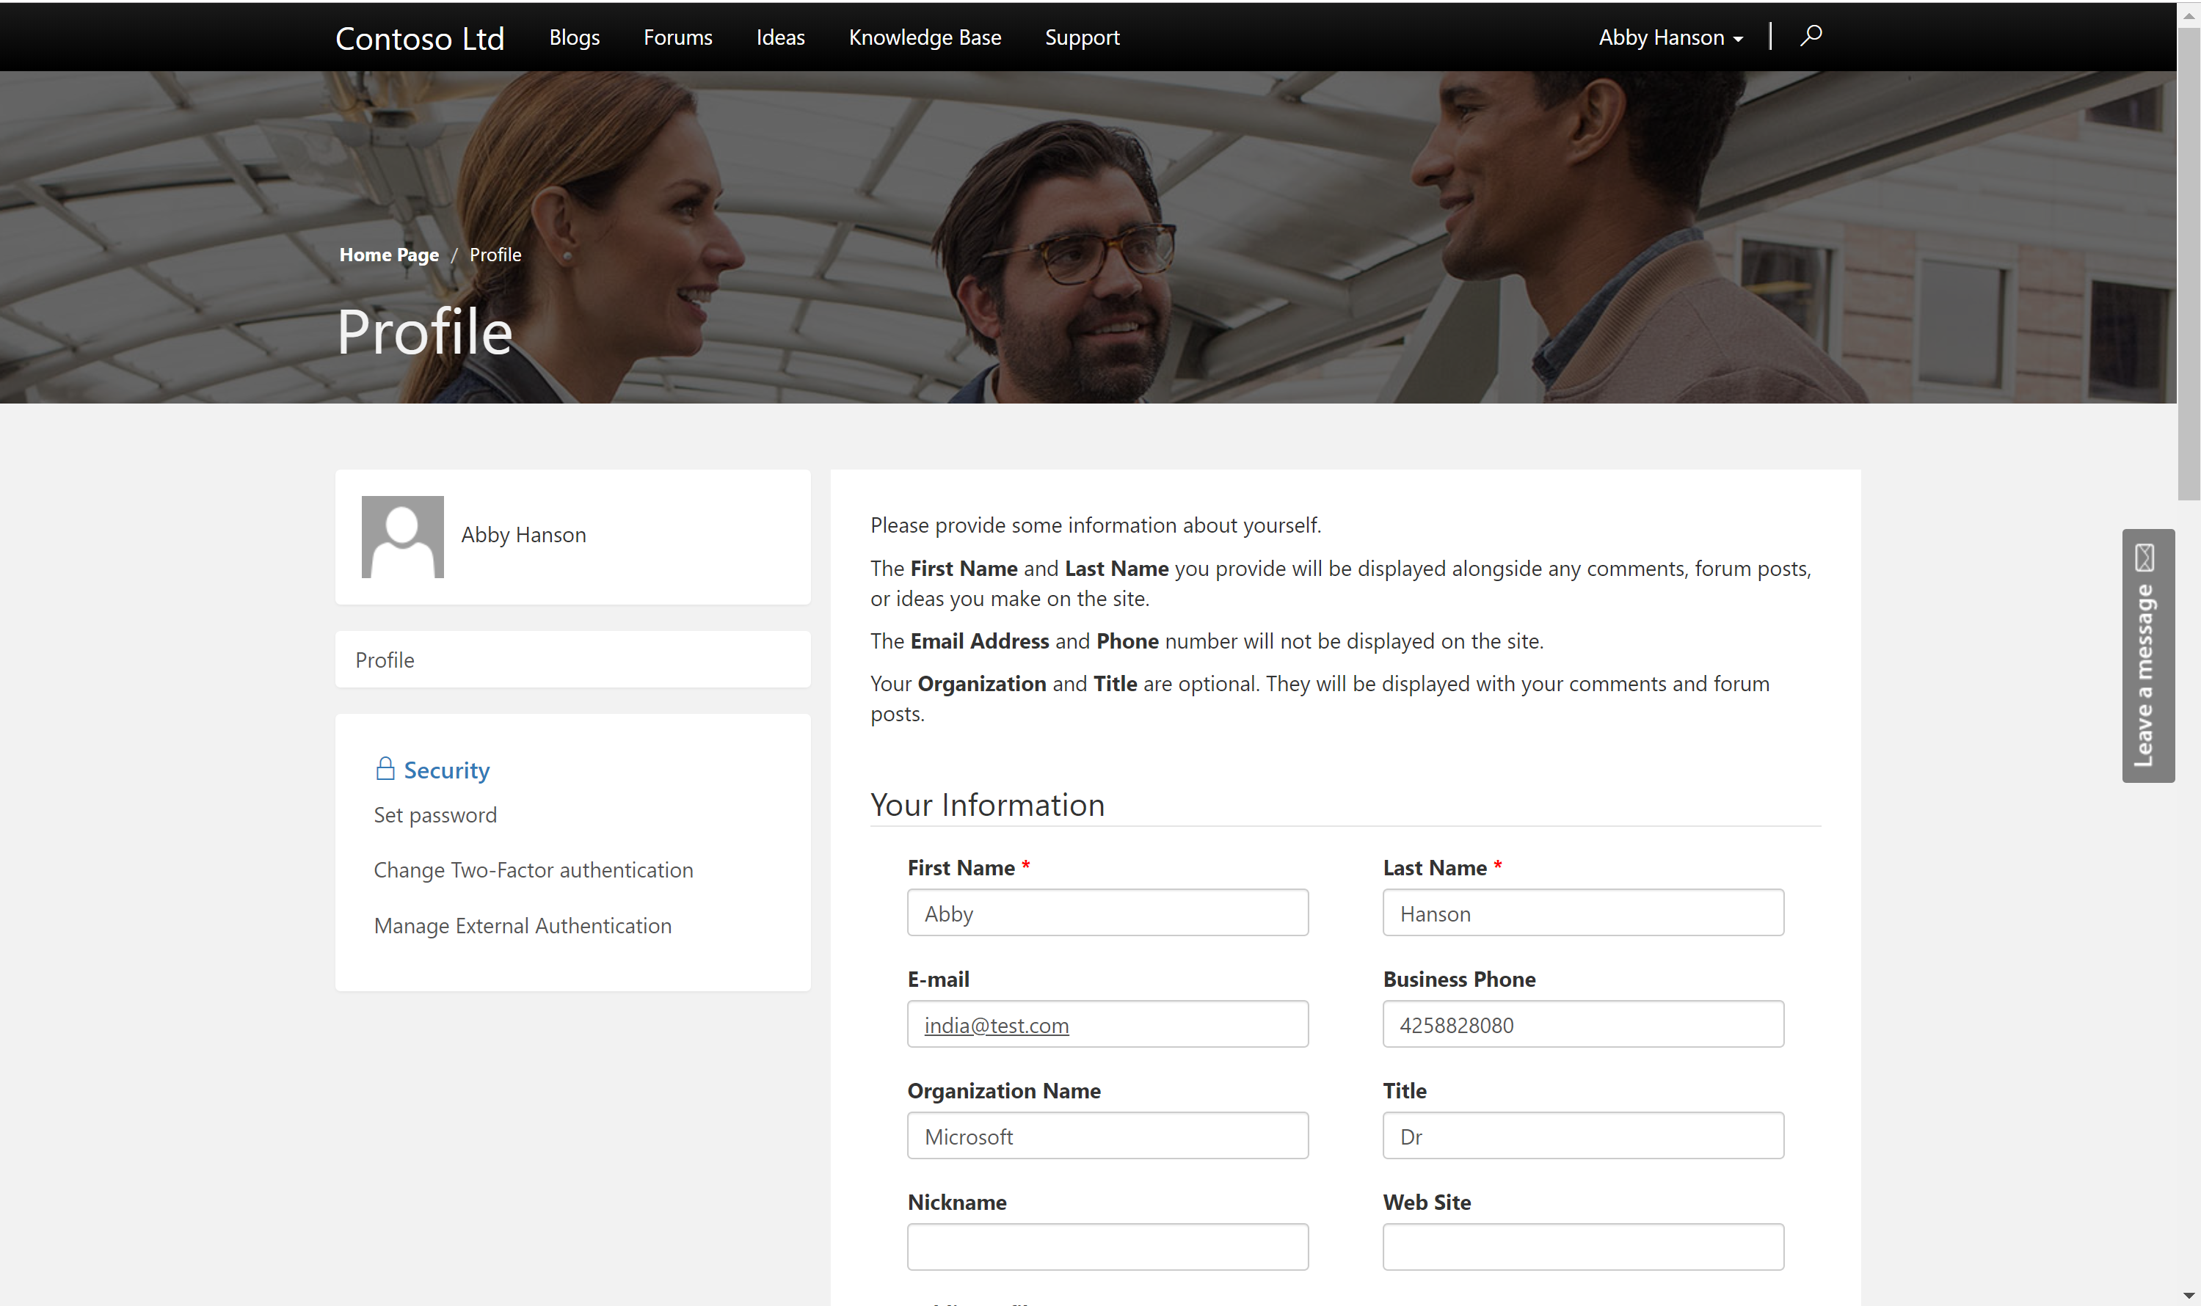
Profile Management and Security Model
All Portal users are modelled as contacts in CDS database.
Contact/Account based security model optimized for B2C as well as B2B interactions.
Self Service Profile Management right within the portal.
Allow users to link identities from multiple identity providers.

Slide 10
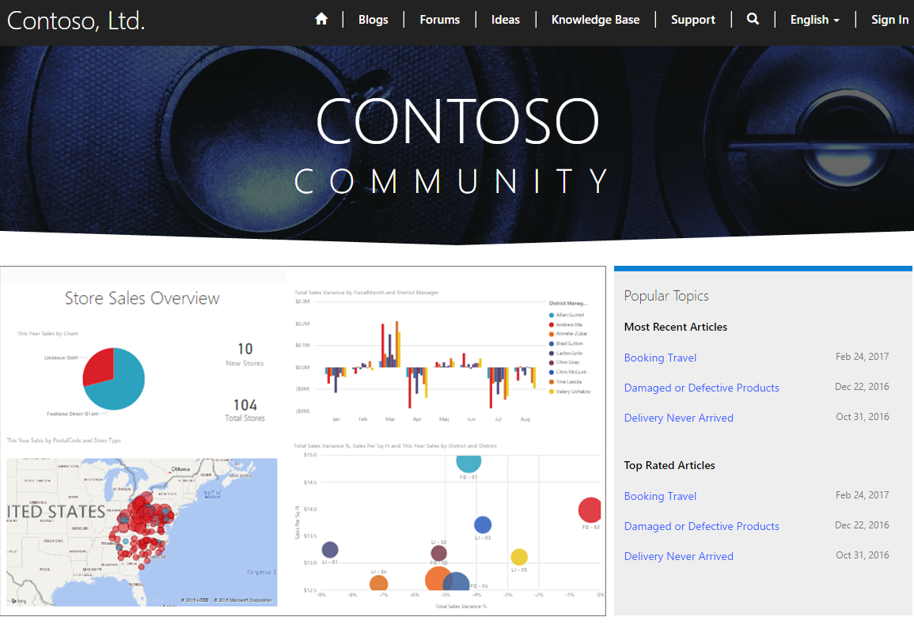
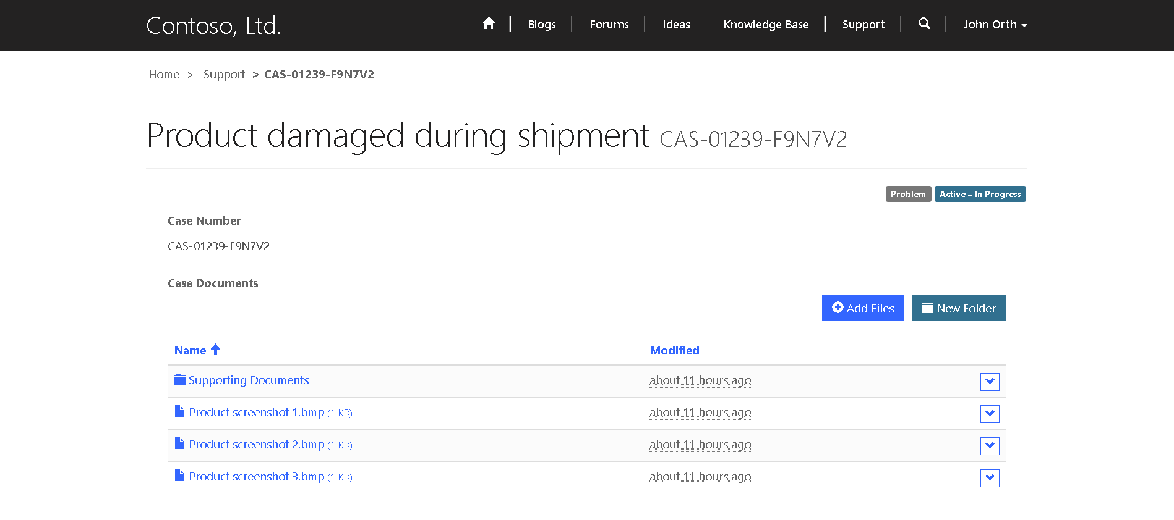
Integrate with other Microsoft Services
Integrate PowerBI embed components like reports, dashboards and tiles.
Integrate SharePoint, Azure Blob storage as document storage.
Integrate with Azure AD B2C as Identity provider
Integrate with Azure Application Insights for usage telemetry, Azure Application Gateway for providing additional security

Slide 11
Pro dev Extensibility and Governance
Ability to access CDS data and enable personalization using liquid templating language.
Ability to create reusable web templates for defining page layouts as well as web services.
Use CDS server-side constructs like code plugins, workflows as well as Microsoft flow to extend business logic.
Advanced admin options like IP address filtering, server-side logs, Portal Checker and many more

Slide 12

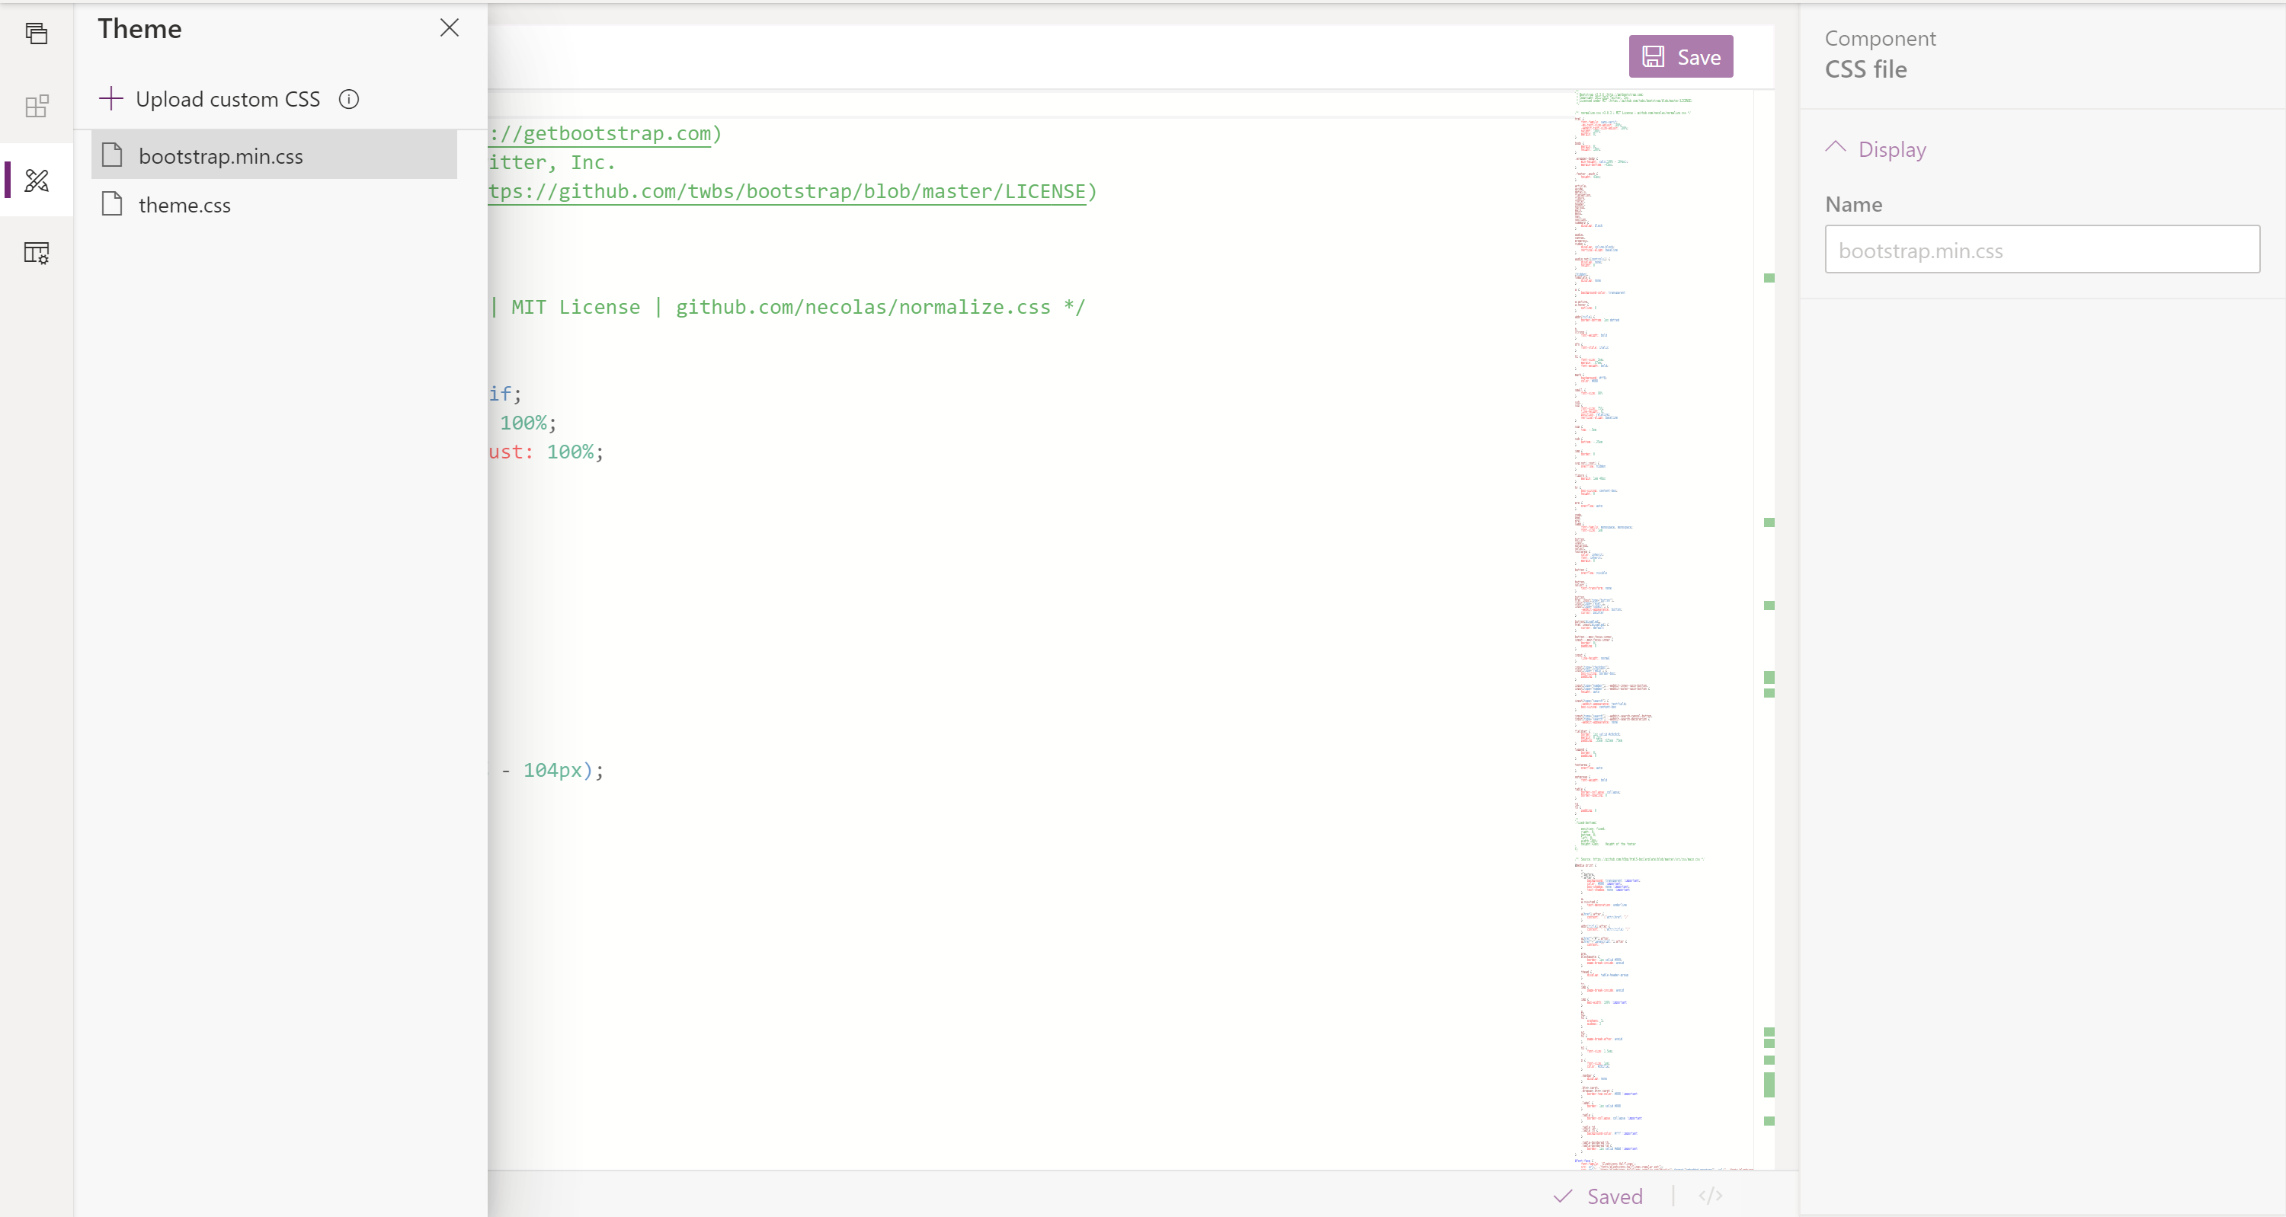
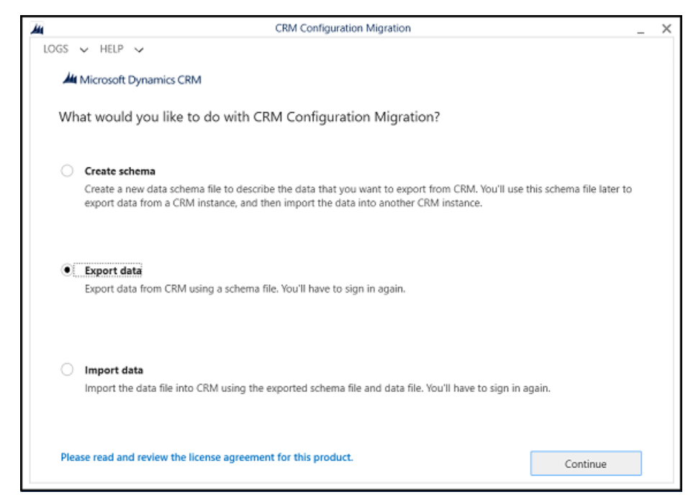
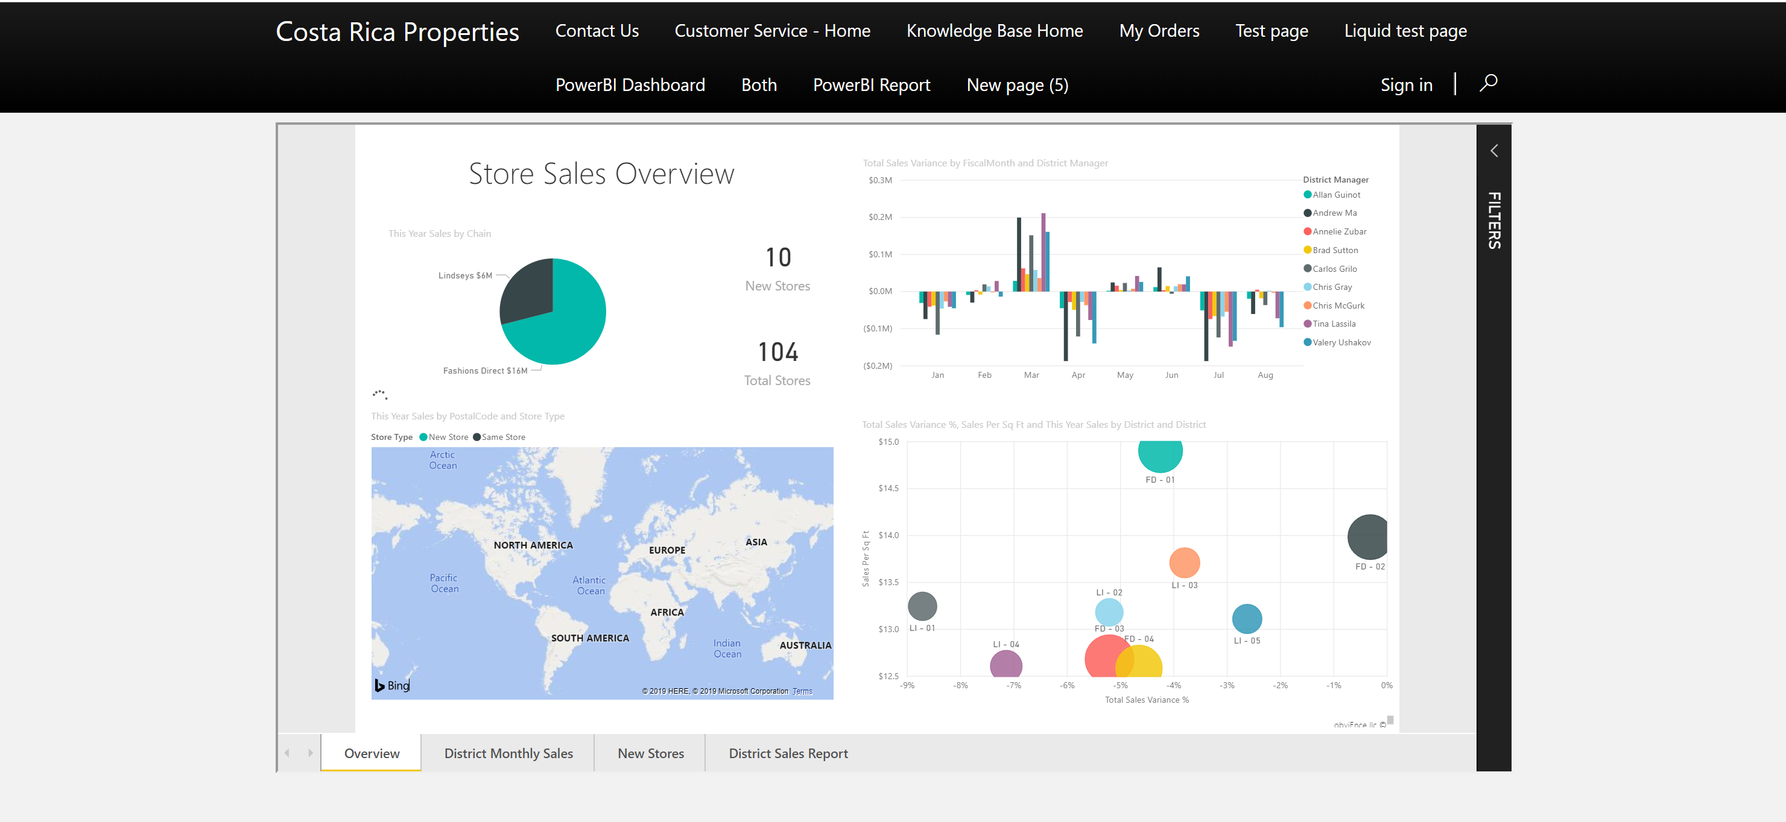
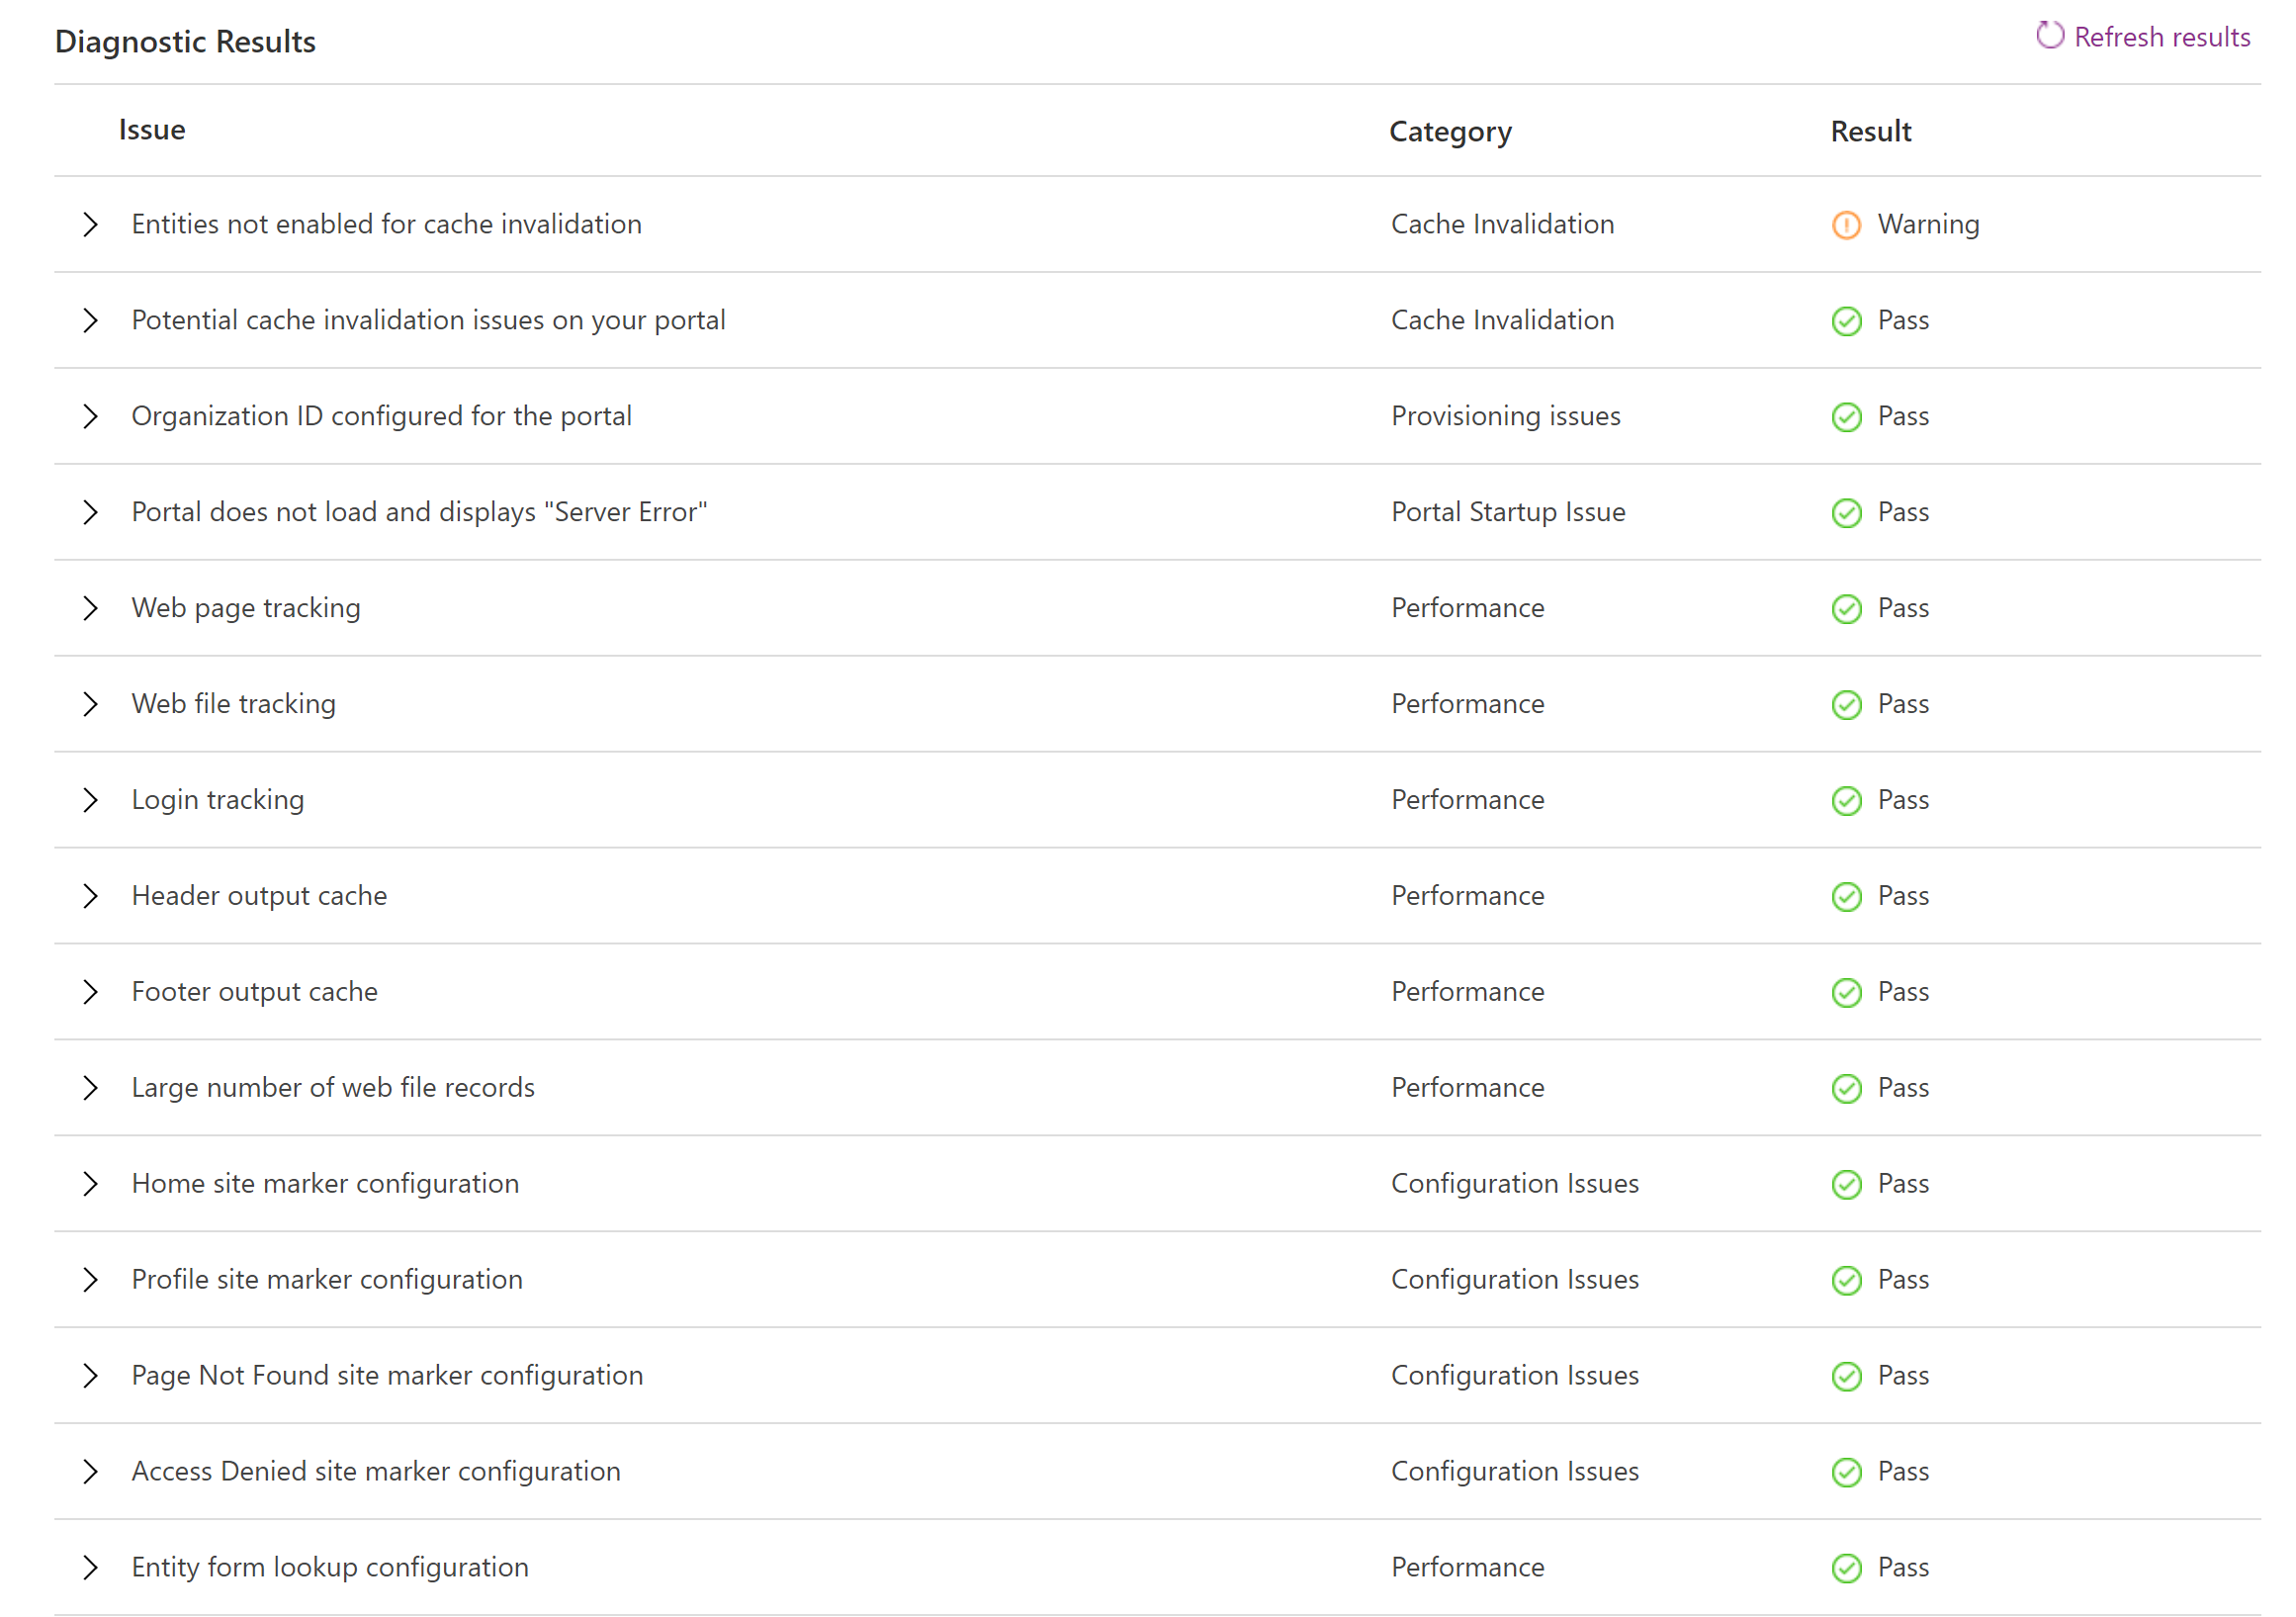
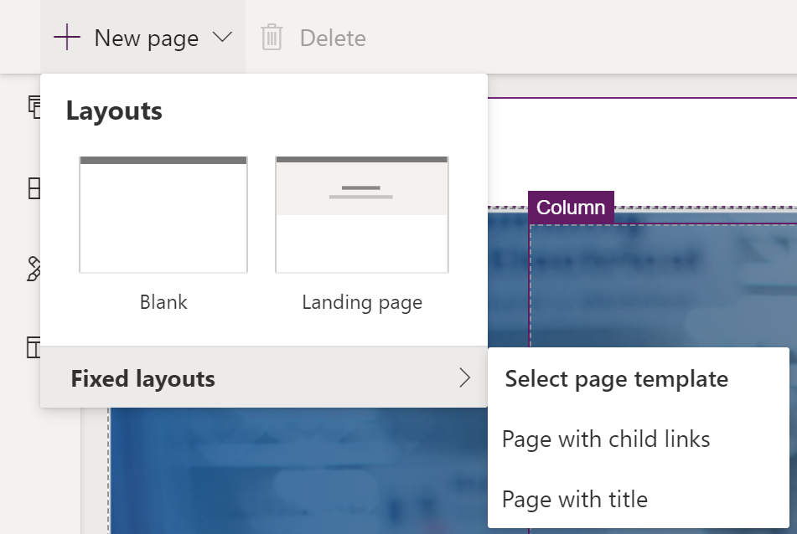
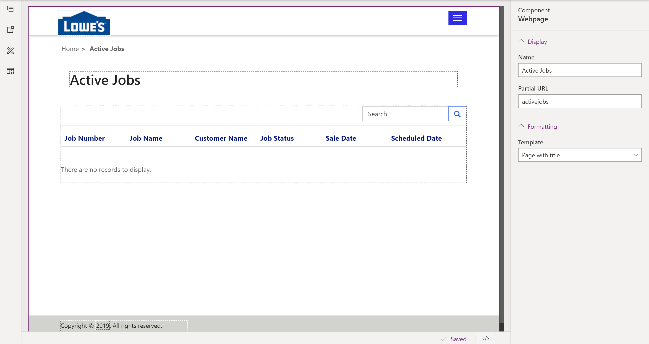
What’s New
Theming Support in Portal Design Studio
CDS Portal Migration Schema
PowerBI Embedded GA
New Portal Checker Rules
Page Layouts
Portal Design Studio Enhancements – List preview and liquid rendering

Slide 13
Coming soon – Wave 1
Web APIs for CRUD operations on Common Data Service entities
Portal Checker enhancements
Simplified themes in portals Studio
Support for additional entities in global search
Support for Authorization Code flow for OpenId Connect based authentication providers
Simplified permission management

Slide 14
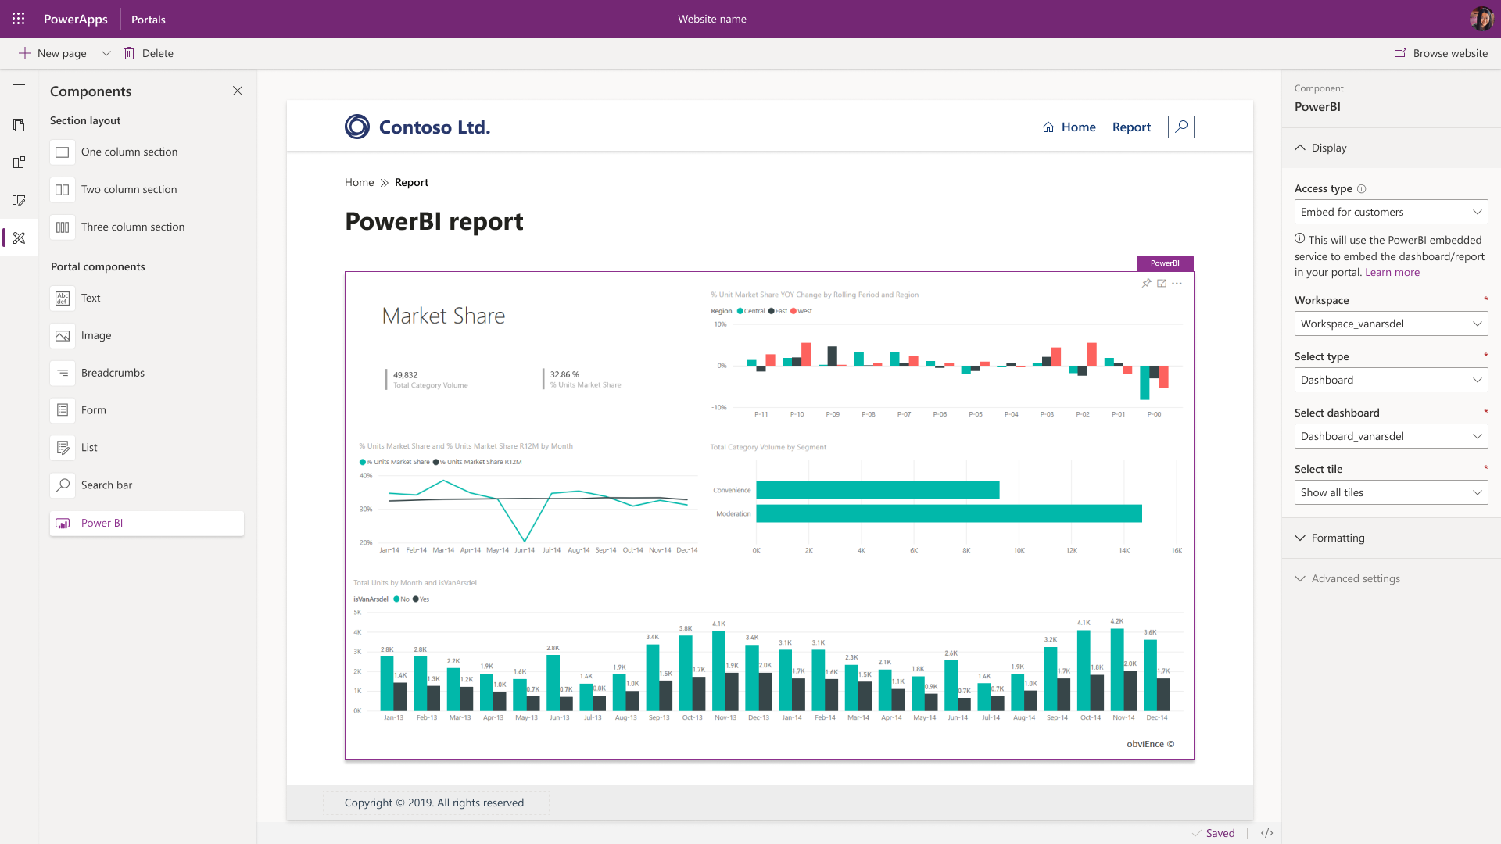
Power BI Embedded component in portal designer
Notes:
Embedding the Power BI in portal using liquid tag is quite cumbersome work, as maker has to get require data from Power BI and pass these values to appropriate parameter in liquid code.
With this feature we aimed at enabling Power BI Embedded as a first-class component in portal designer experience similar to Forms and List. So, maker can add require Power BI report or dashboard in portal by using the portal designer property panel, without worrying about the liquid code.

Slide 15
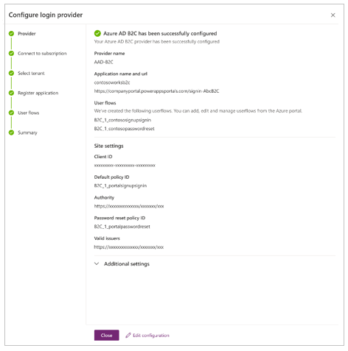
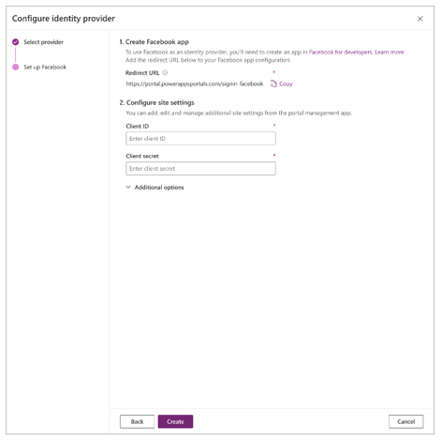
Simplified portal identity provider configuration
Notes:
The authentication setup experience today is complex and involves multiple steps. With the Azure Active Directory B2C as a provider, we make the experience easier with a step-by-step wizard and automate as much as possible so a user does not have to follow long documentation steps configuring all of this manually.

Slide 16
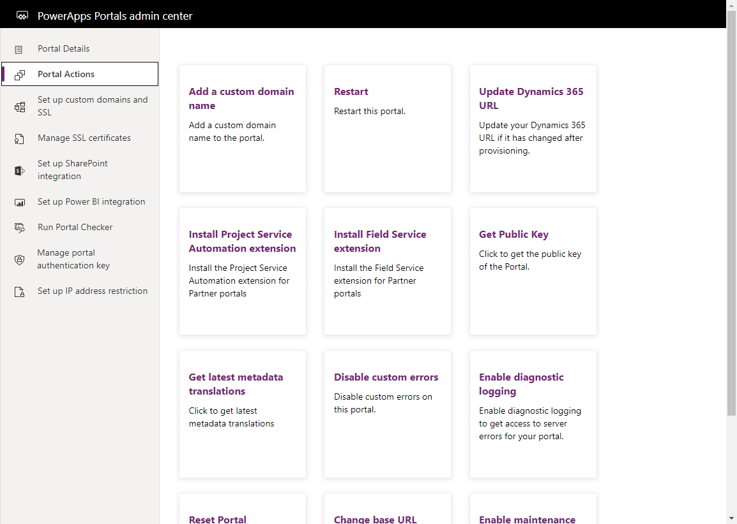
Power Apps Portal Tools – Admin Center

Slide 17
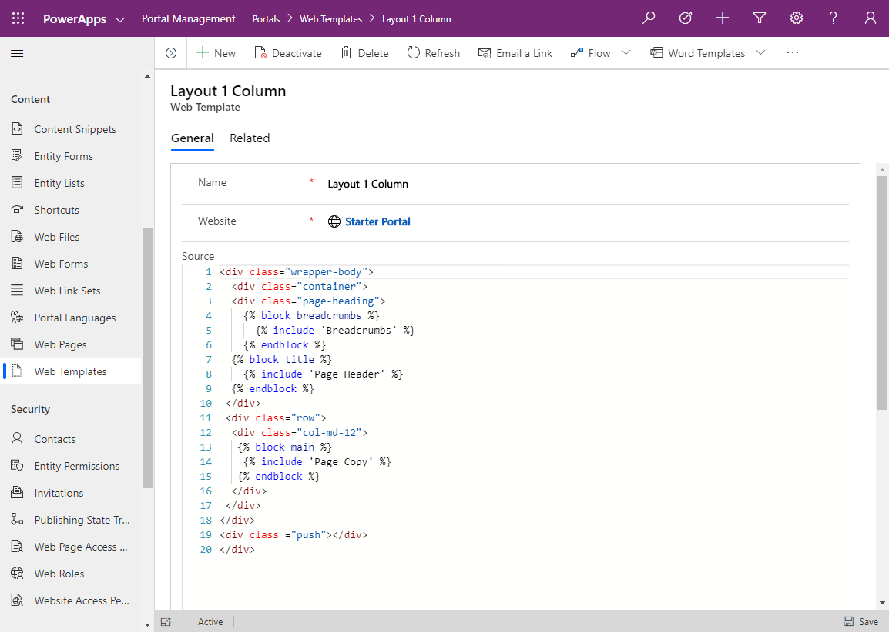
Power Apps Portal Tools – Management App

Slide 18
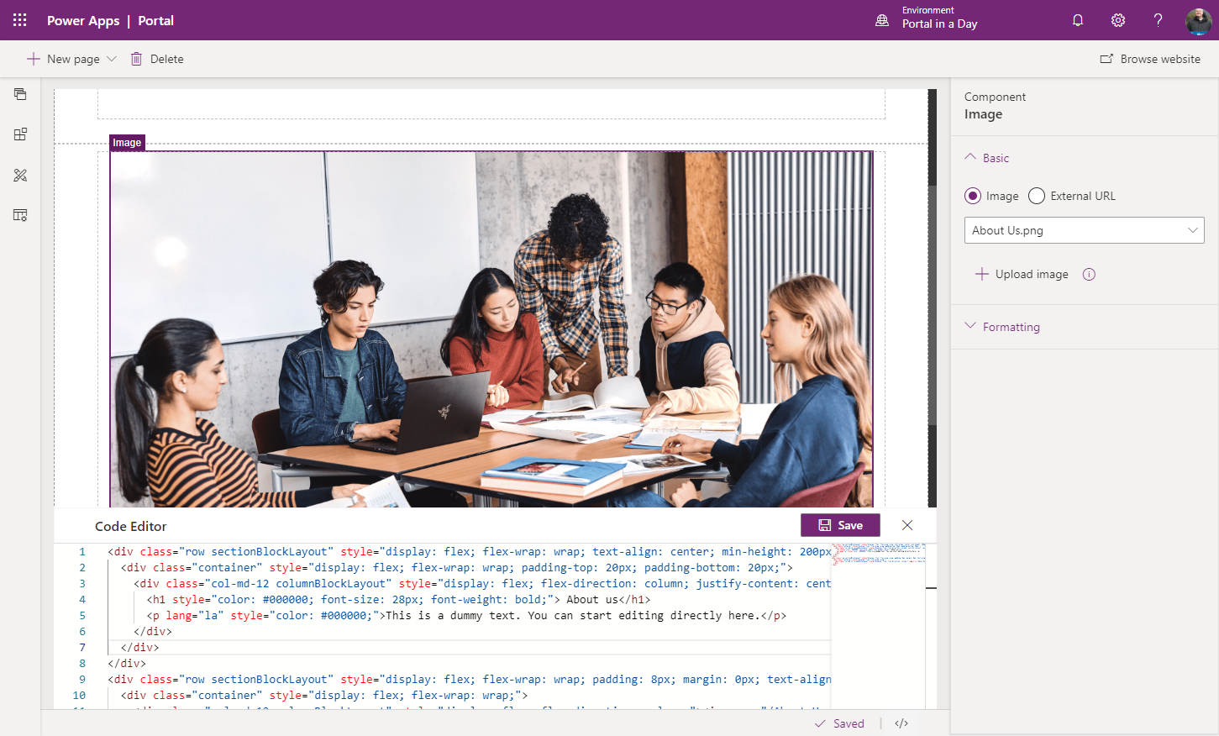
Power Apps Portal Tools – Design Studio

Slide 19
Learning Resources
https://docs.microsoft.com/en-us/learn/paths/extend-dynamics-365-portals/
https://docs.microsoft.com/en-us/learn/paths/work-with-portals-in-dynamics-365/
https://docs.microsoft.com/en-us/learn/paths/get-started-dynamics-365-portals/

Slide 20

Thank you

